Slide 1
Argument essay
English 11

Slide 2
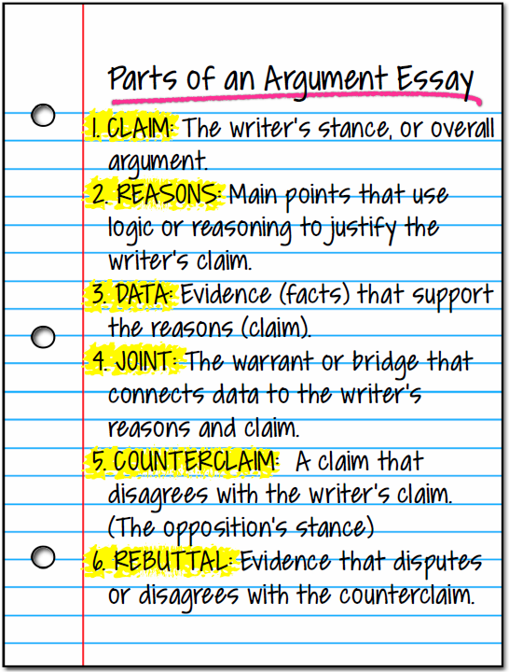

Slide 3
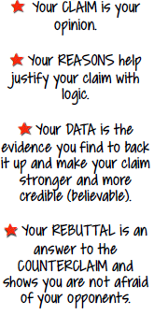

Slide 5
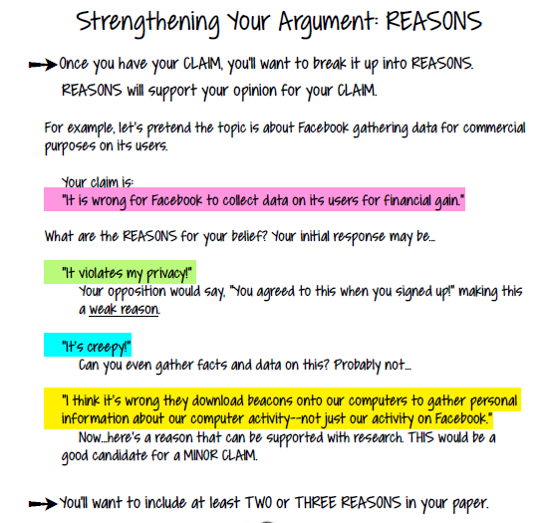

Slide 6
What does your gut say?
Argument Writing Topics and Reactions

Slide 7
Building Your Argument: Directions
For each claim, respond to the statement:
Do you agree or disagree? Why?

Slide 8
Cell phones should be banned from all classrooms

Slide 9
Schools should ban the sales of all soft drinks and junk food

Slide 10
Schools should not block/filter the internet

Slide 11
Grades for gym classes should count toward a student’s GPA

Slide 12
Energy drinks should not be sold to anyone under 16

Slide 13
Teachers should not be allowed to be “friends” or “followers” of students on Facebook, Twitter, Instagram, Snapchat, etc.

Slide 14
Minors (people under 18) should be allowed to get a tattoo without a parent’s permission

Slide 15
The punishment for texting and driving should be the same as it is for drinking and driving

Slide 16
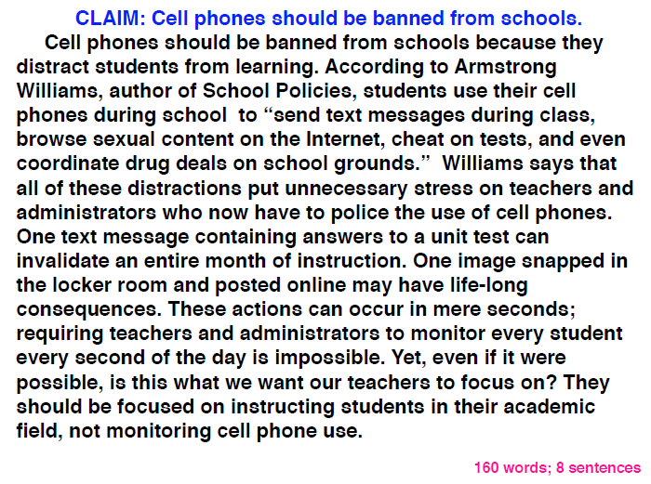

Slide 17
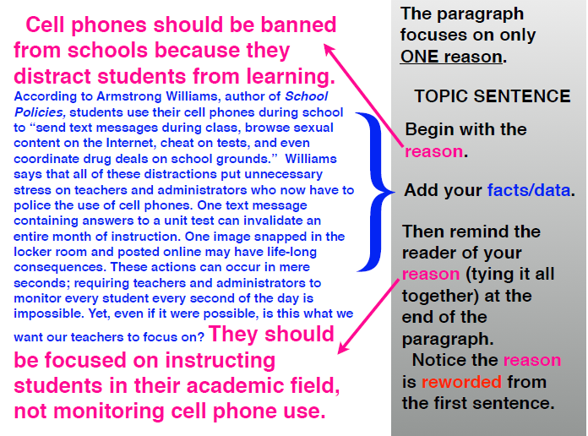

Slide 18
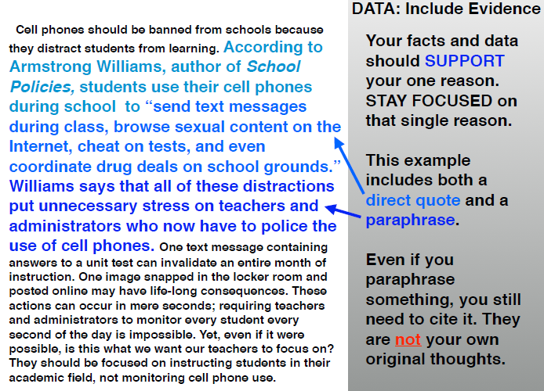

Slide 19
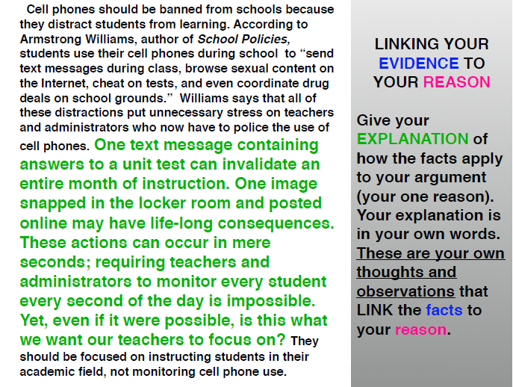

Slide 20
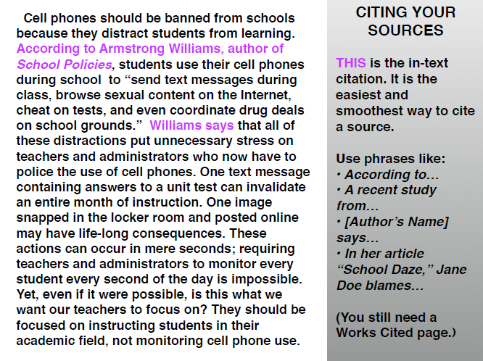

Slide 21
Record Your Sources!
Create a document to copy and paste websites, images, videos, etc. AS YOU SEARCH
It is easy to make a Works Cited page if you keep track of your sources from the beginning

Slide 22
To back up your reason, you will need recent and relevant data
TIP: When searching the web, do NOT type a question into Google… (You will get results from sites like ask.com that may not have credible answers)
INSTEAD: Type your reason directly into the search. This way you will find results that have similar opinions

Slide 23
Credible Websites
iDebate: www.idebate.org
NY Times: http://query.nytimes.com/search/sitesearch
American Civil Liberties Union: https://sssaclu.org
Time magazine: https://content.time.com/time/magazine/archives/advanced
US Constitution- Constitutional Topics: https://www.usconstitution.net/consstop.html
Public Agenda: https://www.publicagenda/org/

